Slide 1
BOR GROUP 2.
MUTUNE CAROLE MUNINI
ANNABEL WAHU
DAVID GACHERU
JEREMIAH MUUTU MBUNU
OGUTU KENETH ORIGA
SUPERVISOR: DR BENJAMIN MUEMA

Slide 2
Forecasting Second Hand Textile Demand and
Associated Waste Generation Using Recurrent Neural
Networks in Nairobi County.

Slide 3
BACKGROUND OF THE STUDY
The second-hand textile sector not only provides affordable clothing options for low-income households (with 91.5% of households purchasing second hand clothes worth less than 1000 shillings and 8.5% purchasing second hand clothes worth more than 1000 shillings) but also serves as a vital source of employment for many individuals engaged in the trade.
This trade has a significant economic impact, with the sector contributing at least 1 billion shillings in revenue per month.
The increased demand of this apparels from the changing fashion trends has led to increased waste from overstocking leading to unsold inventory.
Managing this textile waste has become a critical concern due to more volumes of second-hand textiles being imported every other day hence the more need to forecast the demand of the imports.
This research proposes the use of Recurrent Neural Networks (RNNs) as a powerful predictive tool for modeling and forecasting second-hand textile demand and waste generation patterns in Nairobi County.
RNNs are particularly adept at handling sequential data and can capture intricate temporal dependencies, making them suitable for analyzing trends in consumer behavior over time.

Slide 4
STATEMENT OF THE PROBLEM
Despite the high demand for second hand clothing, import patterns often led to overstocking and unsold inventory.
The lack of proper forecasting tools makes it difficult for businesses and municipalities to anticipate textile demand and prepare for the waste that follows.
This unpredictability leads to insufficient resource allocation, increased dumping and pressure on landfills and on the environment.
We are using LSTM which is a specialized type of Recurrent Neural Network (RNN) that excels at processing and learning sequential data.
It has a flexible memory control through the gating mechanisms which allow information to keep,update or discard.

Slide 5
OBJECTIVES
Main Objective
To use an RNN architecture that forecasts second hand textile demand and associated waste generation in Nairobi County
Specific objectives
i) To identify spikes and trends of the demand and associated waste generated of second hand textile clothing.
ii) To forecast demand of second hand textile clothing and associated waste generated using Long Short Term Memory neural network.
iii) To evaluate performance of the model using statistical metrics..

Slide 6
Literature Review
Introduction
The global surge in textile waste, especially in urban areas like Nairobi County, poses serious environmental and public health risks.
Kenya imported 27,309 tons of second-hand textile clothing in 2023 alone.
Nairobi’s landfills and waterways are overwhelmed, particularly with synthetic and low-quality textiles

Slide 7
Theoretical Framework
Despite improved collection systems (e.g., Clean, Healthy,Wealthy Nairobi initiative (JICA, 2016)), Landfilling remains the default disposal method
The need arises for predictive modeling to support sustainable waste management strategies. . Wang & Zhang (2020): Use of LSTM networks in forecasting fashion/textile waste with nonlinear temporal trends(e.g., seasonal demand spikes, fast-fashion turnover).
Kumar et al. (2021): Identification of the limitations of traditional statistical models in capturing complex waste dynamics.
Chen et al. (2022): Theoretical proposition of a hybrid LSTM-XGBoost model for improved waste prediction.Here, LSTM processes time-series data (e.g., monthly textile imports, GDP fluctuations)

Slide 8
Empirical Review
Recycling and upcycling initiatives are active in Nairobi—e.g., Takataka Solutions, Africa Collect Textiles, and other startups.
These initiatives face challenges like unreliable data, poor infrastructure, and lack of predictive tools.
Africa Collect Textiles estimates 30–40% of imported second-hand clothes are of such poor quality that they cannot be sold
Recommendations include supporting local recyclers through brand collaborations, funding, and global market access.
Reuse examples include turning fabrics into cleaning cloths or using fibers for soil reinforcement.
The approach supports a participatory circular economy, such as the "mali mali" system, where communities exchange old clothes for recycled good

Slide 9
METHODOLOGY
A recurrent neural network (RNN) is an improved multilayer perceptron network, which includes
Input layer
hidden layer
output layer.
The vanishing gradient problem makes it hard for the network to learn from previous inputs because updates are too tiny during the calculation of the back-propagation which makes the influence of the input unable to be transferred.
To address the problem of vanishing gradients, we use Long Short Term Memory to control the flow of information and keep the gradient stable during the predicted frame.
A typical LSTM NN cell is configured mainly by four gates:
Input gate: takes a new input point from outside and process newly coming data.
Input node: input node takes input from the output of the LSTM NN cell in the last iteration.
Forget gate: Decides when to forget the output results and thus selects the optimal time lag for the input sequence.
Output gate: takes all results calculated and generate output for the LSTM NN cell.

Slide 10
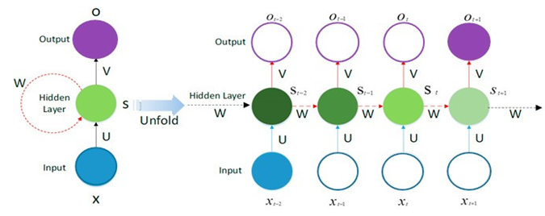
AN UNFOLDED RNN CELL

Slide 11
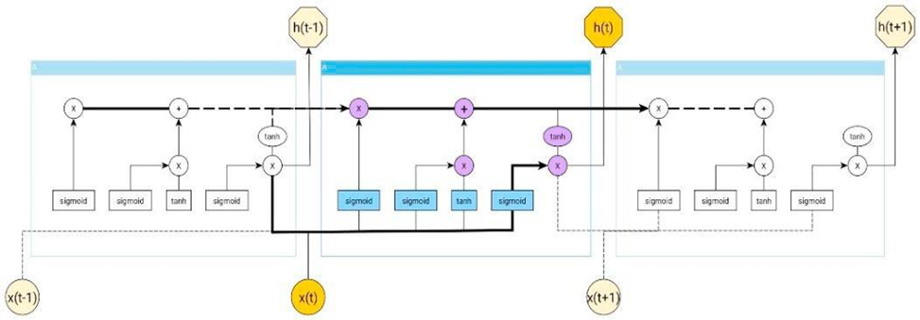
LSTM CELL

Slide 12
The LSTM structure is implemented through the following functions:
𝑖𝑡= 𝜎(𝑊𝑥i𝑥𝑡 + 𝑊ℎi ℎ𝑡−1 + 𝑊𝑐i𝑐𝑡−1 + 𝑏i)
𝑓𝑡 = 𝜎(𝑊𝑥f𝑥𝑡 + 𝑊ℎf ℎ𝑡−1 + 𝑊𝑐f𝑐𝑡−1 + 𝑏f)
𝑐_{𝑡} = 𝑓_{𝑡} ∗ 𝑐_{𝑡−1} + 𝑖_{𝑡} ∗ tan ℎ (𝑊_{𝑥𝑐}𝑥_{𝑡} + 𝑊_{ℎ𝑐}ℎ_{𝑡−1} + 𝑏_{𝑐}
𝑜𝑡 = 𝜎(𝑊𝑥o𝑥𝑡 +𝑊_{ℎo}ℎ_{𝑡−1} + 𝑊𝑐o𝑐t + 𝑏o)
ℎ_{𝑡} = 𝑜_{𝑡} tan ℎ (𝑐_{𝑡})
Where t=1,…,T
i, f, o and c denote the mentioned inner-cell gates, respectively the input gate, forget gate, output gate, and cell activation vectors.
Let us denote the input time series as X =(𝑥, 𝑥₂, … , 𝑥_{𝑇})
hidden state cells as 𝐻 = (ℎ₁, ℎ₂, … ℎ_{𝑇})
output sequence as 𝑌 = (𝑦₁, 𝑦₂, … , 𝑦_{𝑇})
LSTM NNs do the computation as follows:
Hidden state is calculated as: ℎ_{𝑡} = ᴓ(𝑊_{ℎ𝑦}𝑥_{𝑡} + 𝑊_{ℎℎ}ℎ_{𝑡𝑡−1} + 𝑏_{ℎ})
The output is calculated as: 𝑦_{𝑡} = 𝑊_{hy}h_{t}+𝑏_{𝑦}
Where t=1,…,T

Slide 13
Data Collection
Data covers the period 2000 to 2023
Sources include public datasets and reputable organizations
Key data points:
Inflation rates
Second-hand clothing import volumes
Generated textile waste
Average annual temperature
Annual rainfall
Major events affecting textile waste management

Slide 14
Data Sources
Economic & Environmental
Qualitative Contextual Data
KENYS National Bureau of Statistics (KNBS):
Economic Survey
Statistical Abstracts
Import volumes & textile waste statistics
World Bank Open Data:
Used to cross-validate inflation data
Africa Data Hub:
Provided temperature and rainfall data
Collected through:
News articles
Government reports
NGO publications
Covered areas such as:
Policy changes
Economic fluctuations
Environmental interventions
Helps explain trends in textile waste generation

Slide 15
Data Analysis Tools & Libraries
Programming Language: Python
Libraries Used:
Pandas – Data manipulation
NumPy – Numerical operations and efficient arrays
Matplotlib & Seaborn – Data visualization
Scikit-learn – Preprocessing
TensorFlow & Keras – LSTM model building and training

Slide 16
Data Preprocessing Steps
Normalization:
Used MinMaxScaler to normalize numerical features. It transforms the data so that all feature values are scaled to a specific range, typically between 0 and 1.
Categorical Encoding:
Applied LabelEncoder to encode events like policy changes/trade bans
Sliding Window Generation:
Created 3-month rolling sequences to capture temporal dependencies to allow the model to learn temporal dependencies effectively.

Slide 17
Model Architecture
A stacked LSTM model was implemented with the following architecture:
Four hidden LSTM layers
Dropout regularization applied between layers to reduce overfitting
Mean Squared Error (MSE) used as the loss function
The model was trained to predict yearly imports and waste levels based on preceding 3-month sequences

Slide 18
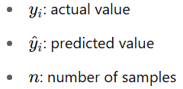

Model evaluation
The LSTM model’s performance was assessed using three key metrics:
Mean Absolute Error (MAE): Measures the average absolute difference between predicted and actual values. Lower MAE values indicate higher accuracy.
Mean Absolute Percentage Error (MAPE): Shows the average prediction error as a percentage. It helps understand model performance in relative terms, with lower percentages indicating better accuracy.
R-squared (R²): Indicates how well the model explains the variability in the data.
The Mean Absolute Error is calculated as:

Slide 19
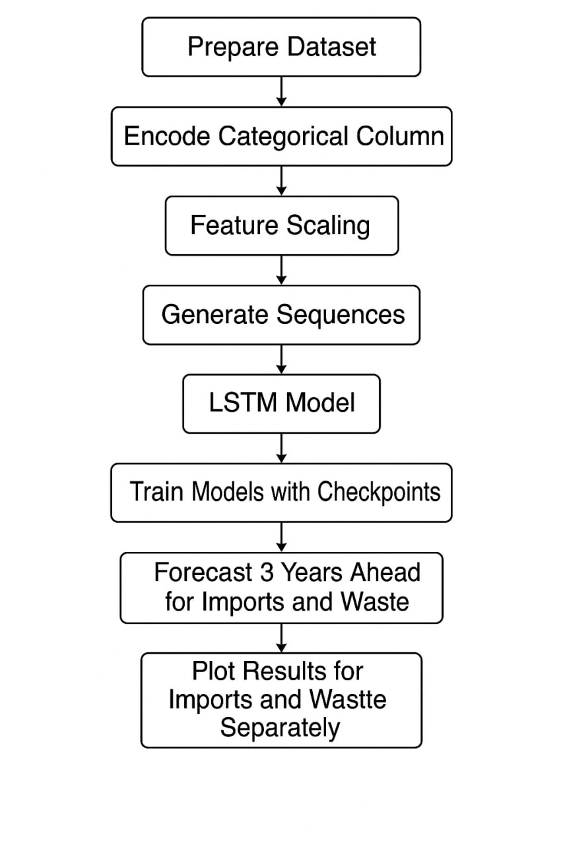

Slide 20
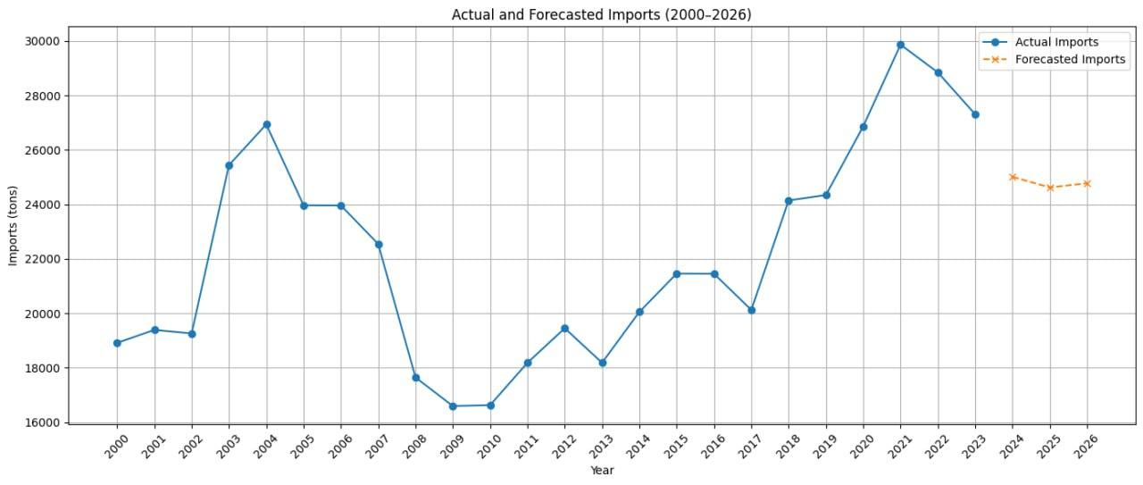
OBJECTIVE 1:Trends and spikes of imports

Slide 21
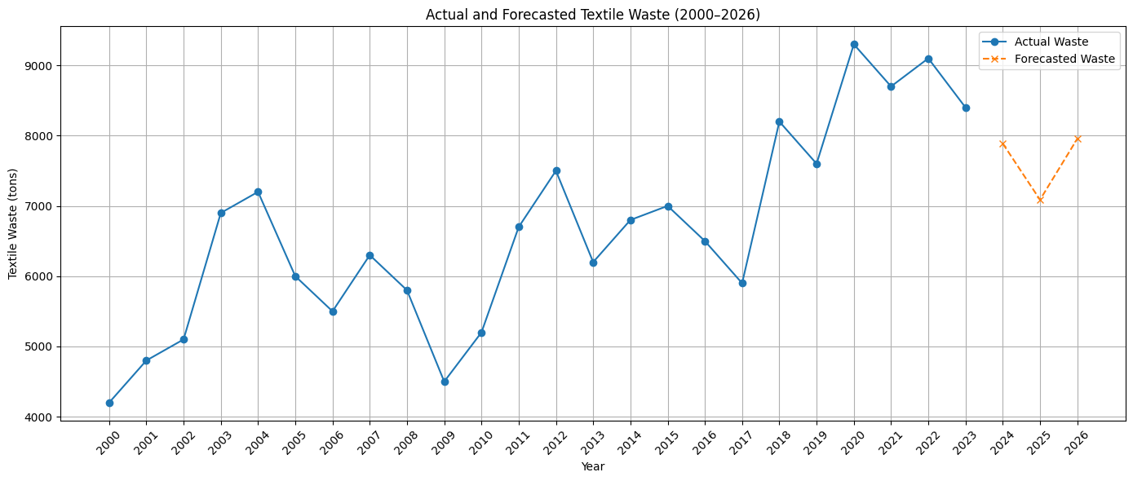
OBJECTIVE 1: Trends and spikes waste generation

Slide 22
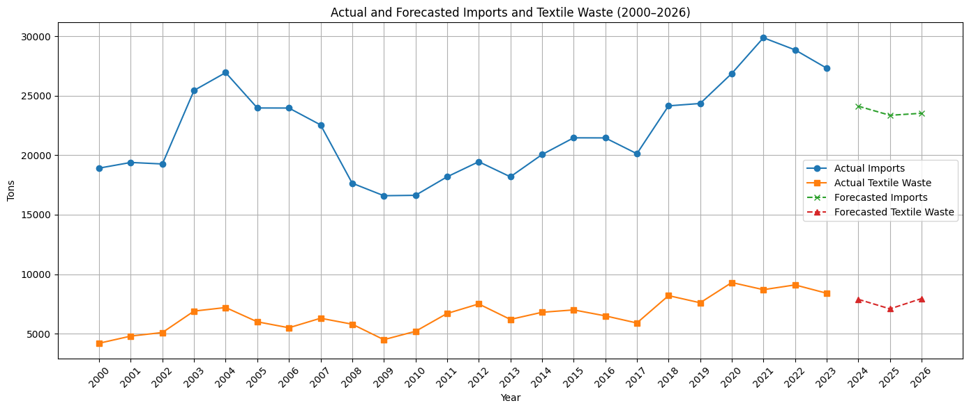
OBJECTIVE 2: Forecasted demand and waste

Slide 23
Forecasted Textile Imports and Waste (2024–2026):
Year Imports (tons) Textile Waste (tons)
2024 24116 7887
2025 23351 7087
2026 23521 7954
GitHub URL to your notebook:
https://github.com/Kenethoriga/DataOpsKit/blob/main/LSTM_FinalBest.ipynb

Slide 24
RESULTS.
Imports Model:
MAE ( 631.07tons): On average, predictions were off by 624 tons.
MAPE (2.94%): The model’s error is 2.74% of actual values, indicating high accuracy.
R² (0.9512): The model explains 95.1% of the variation in import data a very strong fit.
3.4.2.Textile Waste Model:
MAE (218..07 tons): Predictions missed actual values by about 428 tons on average.
MAPE (3.07%): The model has slightly higher error, but still within a good range.
R² (0.9415): Explains 94.1% of the variation in textile waste fairly accurately.

Slide 25
Findings
Stabilization Trend Both textile imports and waste forecasts show relatively stable trends, suggesting that unless significant policy or economic changes occur, Nairobi’s textile consumption and resulting waste might plateau over the next years.
Persistent High Imports Imports remain just above 15,000 tons, indicating sustained demand and inflow of textiles into the local economy. This suggests a strong link between trade patterns and waste generation potential.
Despite improvements in collection systems, the continued reliance on landfilling means even stable waste volumes will accumulate long-term if circular solutions aren’t implemented.
The relatively flat trend in waste generation might mask deeper seasonal or informal waste fluctuations. Thus, more granular (monthly or quarterly) models could be developed.

Slide 26
CONCLUSION
In this study, we used LSTM which is a type of an RNN to forecast the demand of second hand textile and associated waste.By providing accurate demand forecasts, the model can help reduce overstocking, improve how second-hand textiles are sorted and processed, and lower the environmental impact of textile waste.The insights derived from this model can help stakeholders in the second-hand textile sector—including importers, sorters, and waste managers—to make more informed decisions, reduce overstocking, and plan for more sustainable waste management strategies.
Future research can improve this model by including other factors like economic conditions, population changes, or weather patterns. Adding this model to decision-making tools can also support more data-driven and sustainable policies in the textile industry.

Slide 27
RECOMMENDATIONS
1.Develop Policy Based on Forecasting Trends.
2. Promote Data-Driven Decision-Making for Sustainable Practices.
3.Policy recommendations to import tariffs based on demand forecasting.
4. Implement dynamic import schedule (monthly).

Slide 28
REFERENCES
Changing Markets Foundation. (2023). Trashion: The stealth export of waste plastic clothes to Kenya. Retrieved from
https://changingmarkets.org/portfolio/fossil-fashion
Bestseller Foundation. (2023). TakaTaka Textile Recycling. Retrieved from https://bestseller.org/takataka-textile
Africa Collect Textiles. (2021). Africa Textile Collect - Home, Africa Collect Textiles. Retrieved from https://africacollecttextiles.com/
KNBS. (2022b). [Please provide the specific title of the economic survey or report where this data is found]. Kenya National Bureau of Statistics. [If available, provide the URL of the report]
Africa Collect Textiles. (2021). Africa Textile Collect - Home, Africa Collect Textiles. Retrieved from https://africacollecttextiles.com/
Amasuomo, E. (2016, November). The concept of waste and waste management. Journal of Management and Sustainability, 6(4), 88.
https://doi.org/10.5539/jmi.v6n4p88

Slide 29
Gakungu, N., Gitao, A. N., & Kimani, B. (2012, January). Solid waste management in . Environmental Studies,43, 45
Chen, X., Li, Y., & Wang, Z. (2022). Predicting textile waste using a hybrid LSTM and XGBoost model based on economic indicators and purchase behavior. Journal of Waste Management Research, 15(3), 456–470
Bianchi, F., et al. (2021). "A hybrid machine learning approach for textile waste estimation based on socioeconomic factors." Waste Management, 126, 735-745.
Wang, L., & Zhang, G. (2020). "Forecasting fashion waste generation using LSTM neural networks." Resources, Conservation & Recycling, 158, 104798.

Slide 30
Wikipedia contributors. (n.d.). Waste input-output model. Wikipedia. Retrieved April 13, 2025, from https://en.wikipedia.org/wiki/Waste_input-output_model
Şen, S., & Gök, M. Ş. (2016). Fast fashion and second-hand clothes between ecological concerns and global business. In E. A. Idowu, N. Capaldi, L. Zu, & A. D. Gupta (Eds.), Encyclopedia of Corporate Social Responsibility. Springer. https://www.researchgate.net/publication/304626238_FAST_FASHION_AND_SECOND_HAND_CLOTHES_BETWEEN_ECOLOGICAL_CONCERNS_AND_GLOBAL_BUSINESS

Slide 31
Kumar, S., et al. (2021). "Textile waste prediction models: A review of statistical and machine learning approaches." Journal of Cleaner Production, 279, 123686.
Leaders for a Better World. (n.d.). Smart fashion production: Predicting demand to minimize waste. Retrieved April 13, 2025, from https://leadersforabetterworld.net/smart-fashion-production-prediciting-demand-to-minimize-waste
Leaders for a Better World. (n.d.). Smart fashion production: Predicting demand to minimize waste. Retrieved April 13, 2025, from https://leadersforabetterworld.net/smart-fashion-production-prediciting-demand-to-minimize-waste

Slide 32
Wikipedia contributors. (n.d.). Waste input-output model. Wikipedia. Retrieved April 13, 2025, from https://en.wikipedia.org/wiki/Waste_input-output_model
Chen, T., He, T., Benesty, M., Khotilovich, V., & Tang, Y. (2022). XGBoost: Extreme Gradient Boosting. Theoretical framework. [Unpublished manuscript/theoretical framework, depending on source].
Changing Markets. (2023). Trashion: The stealth export of waste plastic clothes to Kenya. Changing Markets Foundation. https://changingmarkets.org
Ellen MacArthur Foundation. (2015). Towards a circular economy: Business rationale for an accelerated transition. https://ellenmacarthurfoundation.org

Slide 33
Holland, J. H. (1995). Hidden order: How adaptation builds complexity. Addison-Wesley.
JICA. (2016). The Project on Integrated Solid Waste Management in Nairobi City: Final Report. Japan International Cooperation Agency. https://www.jica.go.jp
Kenya National Bureau of Statistics (KNBS). (2022b). Kenya Economic Survey 2022. Nairobi: KNBS.
Kibera Muthoni. (2021). Toxic threads: The hidden environmental and health crisis of textile waste in Nairobi. Environmental Watch Kenya

Slide 34
Kumar, S., Dixit, G., & Rathore, A. P. (2021). Challenges in modeling solid waste: An integrated approach. Journal of Environmental Management, 283, 111977. https://doi.org/10.1016/j.jenvman.2021.111977
Mugambi, M., Kinoti, M., & Wamukoya, J. (2020). Urban waste management in Nairobi: Challenges and opportunities. African Journal of Environmental Studies, 8(2), 102–115.
Njoroge, J., Kimani, M., & Ndunge, D. (2014). Review of municipal solid waste management: A case study of Nairobi, Kenya. International Journal of Engineering Research & Applications, 4(5), 62–66.

Slide 35
THE END

